Slide 1
Pokémon Classification Project
Charles Hyland 450411920
Rowena Kok 440256380

Slide 2

Meet Ash
Aspiring Pokémon Trainer
Loves battling new Pokémon
Often in regions with little medical facilities

Slide 3
There’s more.
Attacks on Pokémon trainers rising
Capacity to analyse unidentified Pokémon is falling

Slide 4
Business Application
Wild Pokémon appearing
Trainers getting attacked
Cities getting ruined

Slide 5
Project Timeline.
Exploratory Data Analysis.
Model Evaluation
Deployment
Model Training
Notes:
Timeline implementing
Financially feasible
Use the Sky-Muster Satellite system (NBN) to provide access to the database.
Roll out in established centres first (Darwin and Alice Springs), and extend towards regional town centres

Slide 6

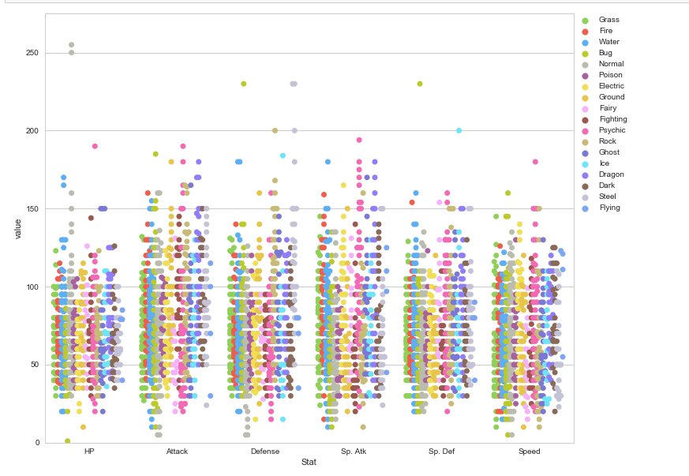
Distribution of Attributes.
Data is of a high quality
Attributes evenly distributed
Water and Normal type Pokémon most frequent

Slide 7

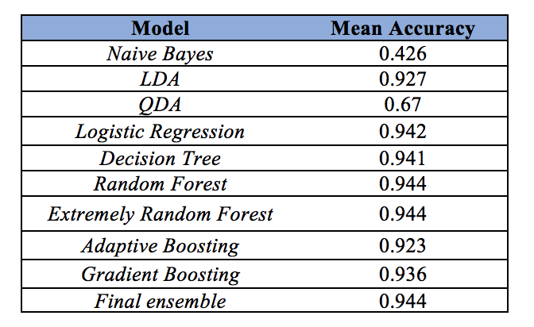
Results.
High accuracy in models we have constructed
Strong performance
94% accuracy rate

Slide 8

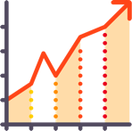


Applications.
Able to save Pokémon trainer’s lives
Improve efficiency of identifying Pokémon
Save cost and time in identifying Pokémon

